Slide 1



Variation in GC content blurs the relationship between selection efficacy and genome size in flies
Annabelle Haudry
Equipe Le Cocon
avec
Vincent Merel, Théo Tricou, Nelly Burlet
credit: DALLE.E

Slide 2
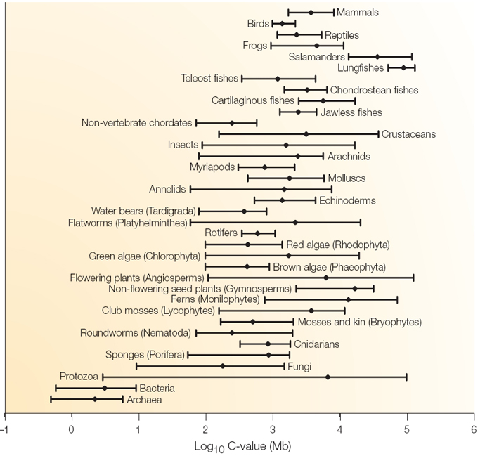
Extensive variation in genome size within and among the main groups of life
Pray, L. (2008)

Slide 3

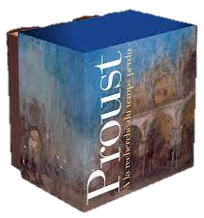
Extensive variation in genome size within and among the main groups of life
Human genome ~3 Gb
Pray, L. (2008)

Slide 4

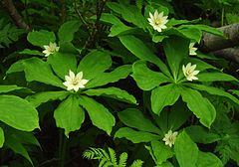
Extensive variation in genome size within and among the main groups of life
Human genome ~3 Gb
genome ~149 Gb
Paris japonica holds the current record for largest genome Pellicier et al. 2010
Pray, L. (2008)
Notes:
'amibe microscopique qui se distingue par la taille de son génome qui serait le plus grand du monde vivant connu avec 675 milliard de paires de bases

Slide 5
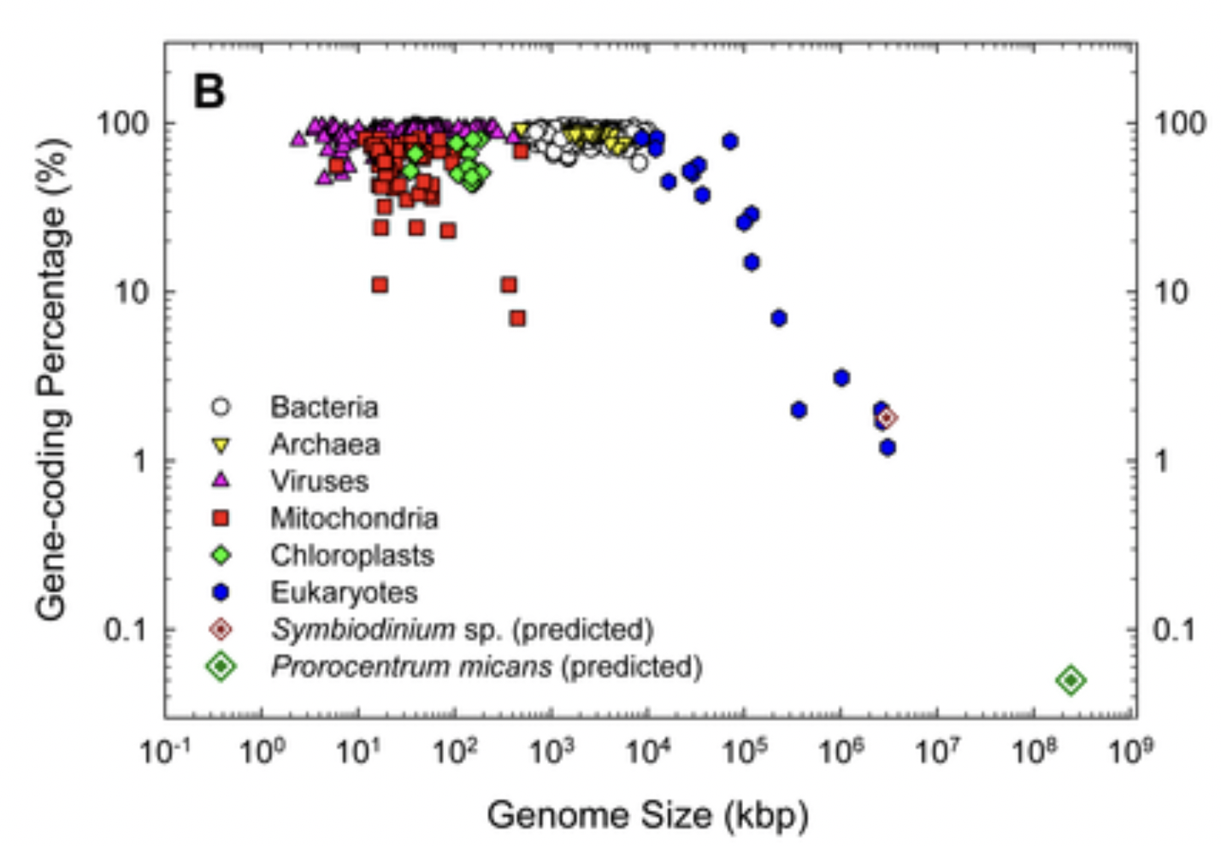
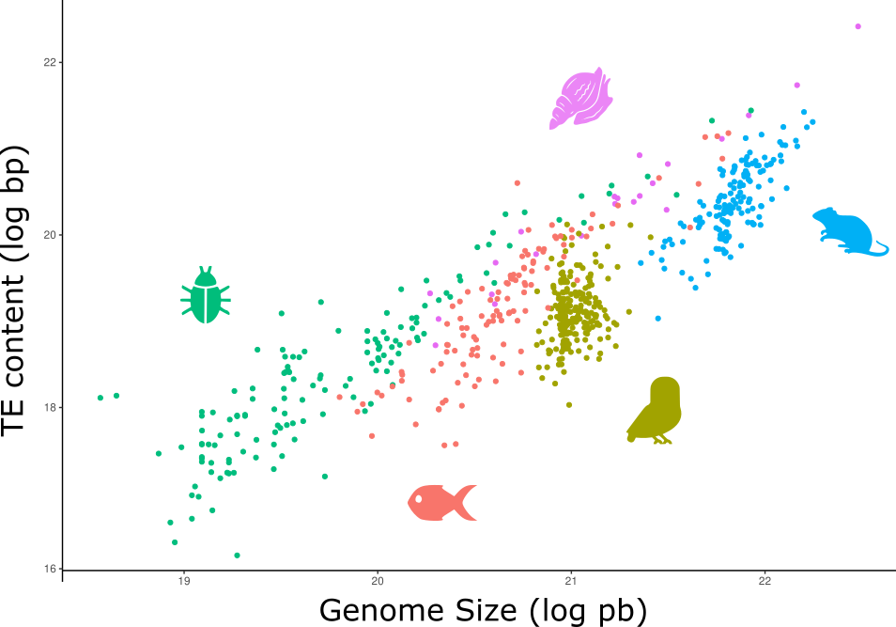
Transposables Elements are major factors of genome size in Eukaryotes
while content in protein coding genes is not!
Hou & Lin (2009)
Marino et al. (work in progress)

Slide 6
Transposables Elements are major factors of genome size in Eukaryotes
But why do some species accumulate more TEs than others in their genome?
Marino et al. (work in progress)

Slide 7
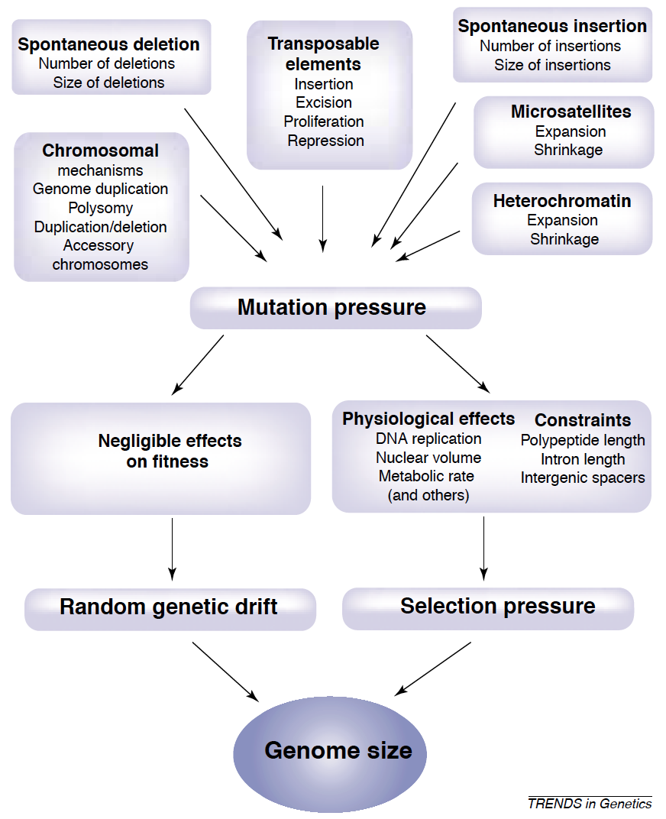
What is driving TE (non) accumulation in genomes?
Ne
Petrov (2001)

Slide 8


What is driving TE (non) accumulation in genomes?
Ne
Ne
Drift
Drift
Ne
Petrov (2001)

Slide 9
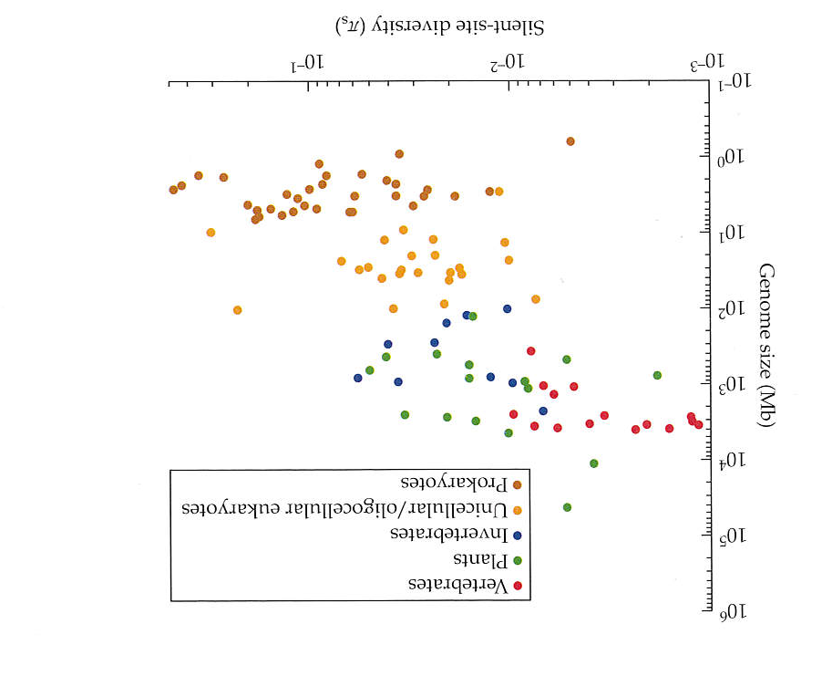
What is driving TE (non) accumulation in genomes?
Ne
Ne
Drift
Drift
~4Neµ
The Origins of Genome Architecture. Lynch (2007)

Slide 10
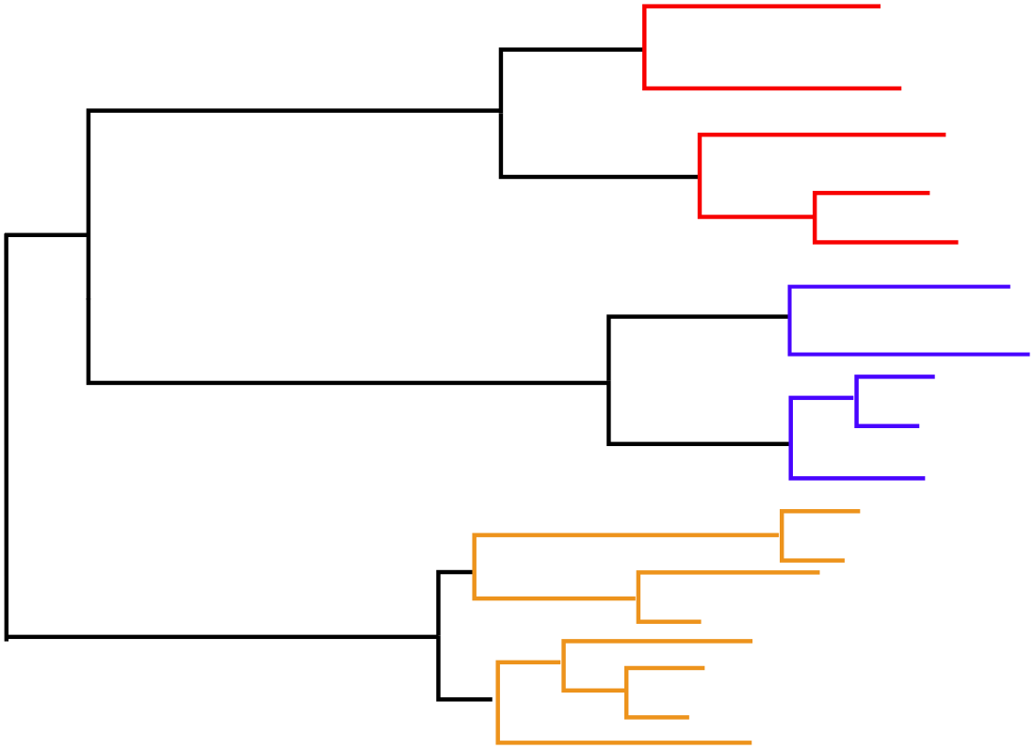
What is driving TE (non) accumulation in genomes?
Phylogenetic inertia
Taxonomy as a confounding factor
The Origins of Genome Architecture. Lynch (2007)

Slide 11









What is driving TE (non) accumulation in genomes?
Mating system
Daphnia
Schaack et al. 2010
Evening primroses
Ågren et al. 2015
Arthropods.
Bast et al. 2016
Eusociality
Snapping shrimps
Chak et al. 2021
Hymenoptera
Kapheim et al. 2015
Parasitism
Amanita fungi
Hess et al. 2014
Subterranean
lifestyle
Asellidae
Lefébure et al. 2017
Butterflies
Mackintosh et al. 2019

Slide 12
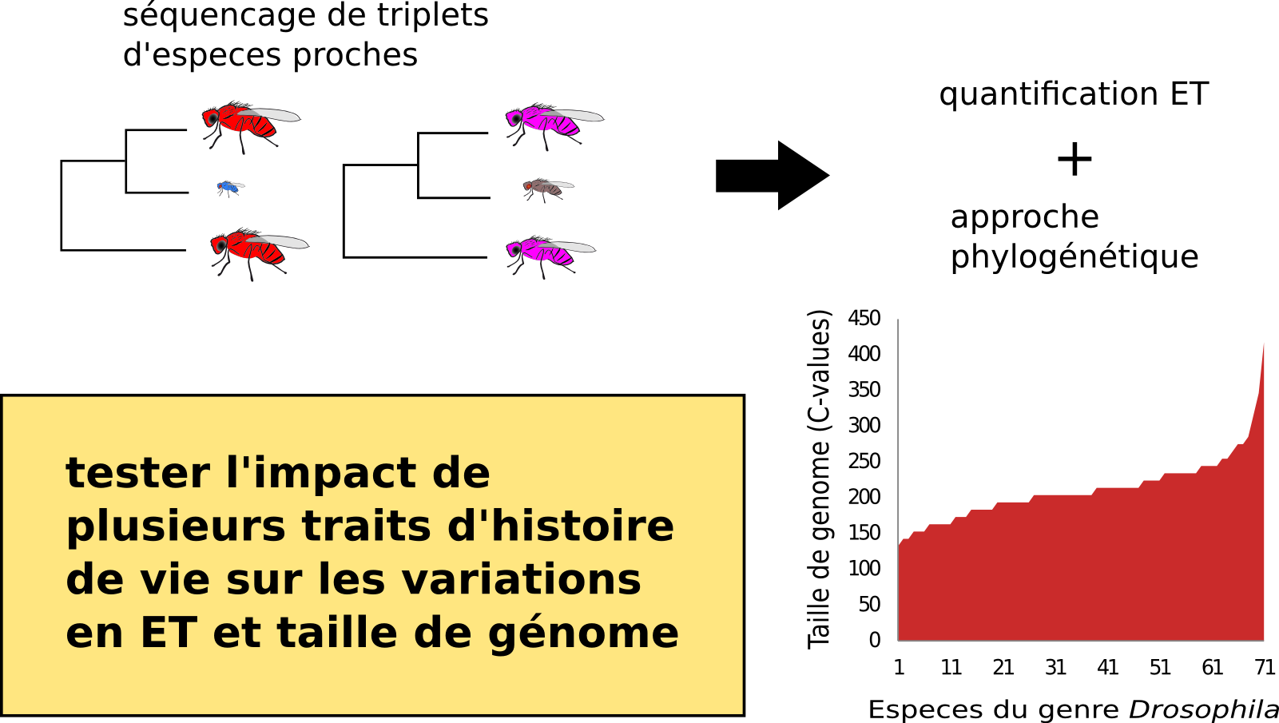
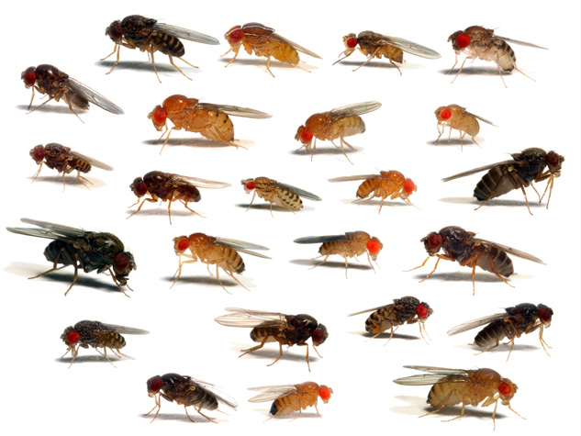
Genomic data available on closely related species. Differences in life history traits and demography (Markow and O’Grady, 2005) Variation in levels of observed heterozygosity (Kim et al. eLife,2021) => possible Ne differences associated with a three-fold variation in genome size
Drosophila: a good complex of species to address this longstanding question?
Est. genome size (Mb)
Species of Drosophila

Slide 13
Quick overview of materials and methods
A balanced sampling, with triplet of closely related species
Whole genome sequencing for 40 species
(+ public data of 42 lines)
Genome size estimates (database + lab flow cytometry)
Estimations of TE content
De novo genome assemblies
Annotation and gene clustering
=> 2,242 gene families single-copy orthologs present in at least 50% of the 82 lineages
Phylogenomic reconstruction
77 species
Notes:
Estimations of TE content. Kraken + dnaPipeTE (0.15X)
De novo genome assemblies UrQt>IDBA/SOAP+Ray>Stats+BUSCO
Annotation and clustering: RepeatMasker>Augustus>MMseqs2>HMMER >SiliX
Only single-copy orthologs present in at least 50% of the 82 lineages,
Alignements + filtering (MACSE + Gblocks) +HMMCleaner for dn/ds estimations.
ML tree on concatenation of all amino-acids alignments using IQ-Tree
+Super tree approach using ASTRAL-III

Slide 14
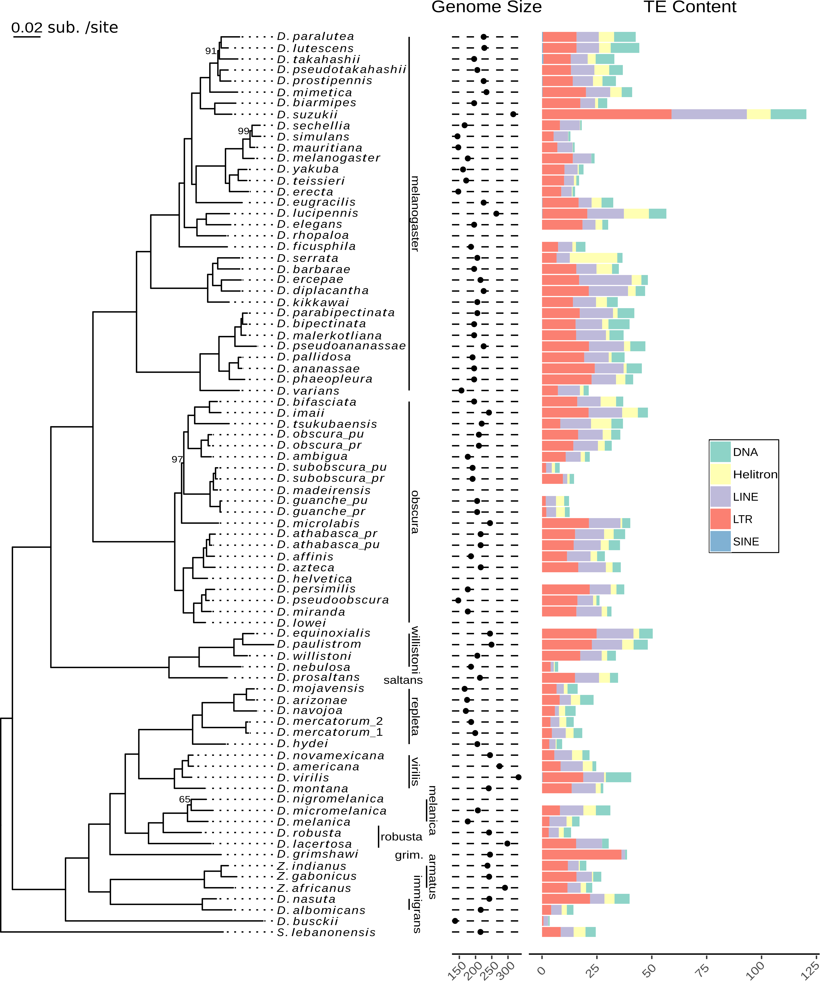
How much variation in genome size is explained by the phylogeny?
Pagel’s λ=0.59
Phylogenetic inertia +
Intra group variation in genome size and TE content.
Genome size:
137Mb in D. busckii to
333 Mb in D. virilis.
TE content:
3.5Mb in D. busckii to
120Mb for D. suzukii.
Merel et al. Coming soon
Notes:
Virilis has a large genome but not that much TEs.
Presence of more and longer microsatellites compared to melanogaster reporter (Schlötterer &Harr, Drosophila virilis Has Long and Highly Polymorphic Microsatellites, MBE 2000)
But also DNA Helitron accumulation according Merel et al. (2020) that we don’t see here.

Slide 15
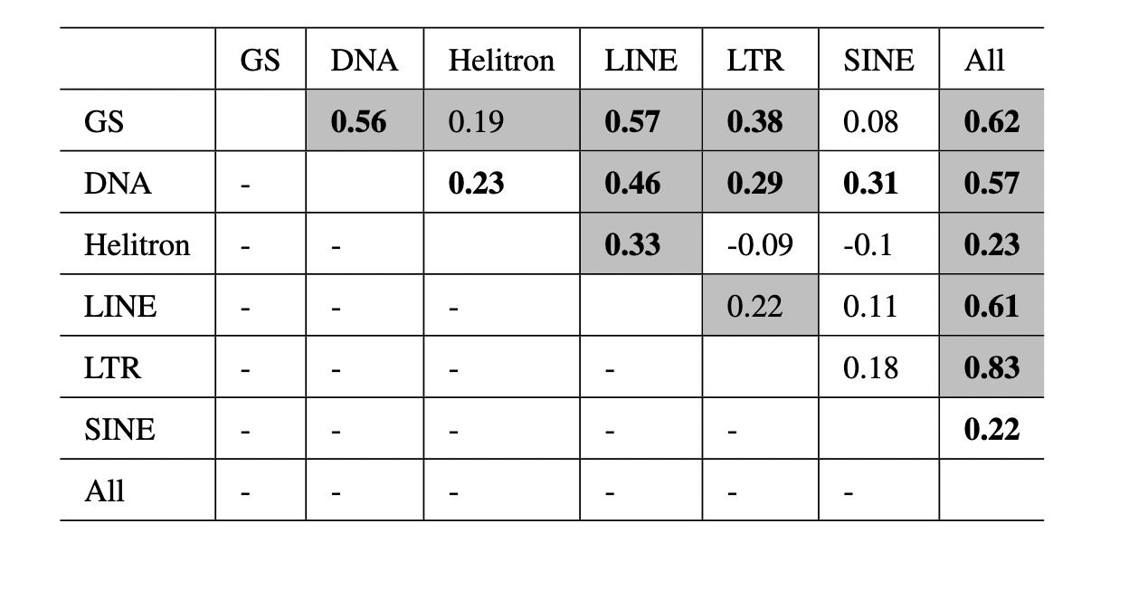
Genome size and TE abundance are positively correlated within flies
Testing correlations while controlling for phylogenetic inertia using ancov (Lartillot, 2014) and PGLS.
Significant correlations in bold ( pp < 0.025 or > 0.975).
Cells in gray correspond to significant PGLS (p_{adjusted} < 0.05)

Slide 16

Which estimates for Ne?
Life History Traits: collection of developmental times estimates from litterature
Evolutionary rate
Strength of selection on Codon Usage Bias: Effective Number of Codons (Novembre's ENC’), synonymous codon bias orderliness (SCUO).
Arg Lys Pro _ Ile Gln Asn Gly Gln
Human CGC AAA CCC --- ATT CAG AAT GGC CAG
Mouse CGC AAG GCC CCG ATG CAG AAT GGT CAG
Arg Lys Ala Pro Met Gln Asn Gly Gln
synonymous substitution rate
non-synonymous substitution rate
out



a







b
d_{N}




c
~ long-term estimate of Ne





d_{S}




d
Notes:
ENC quantifies the degree of deviation from equal use of synonymous codons; ENC’ is similar to ENC but allows comparison to any desired codon distribution.

Slide 17
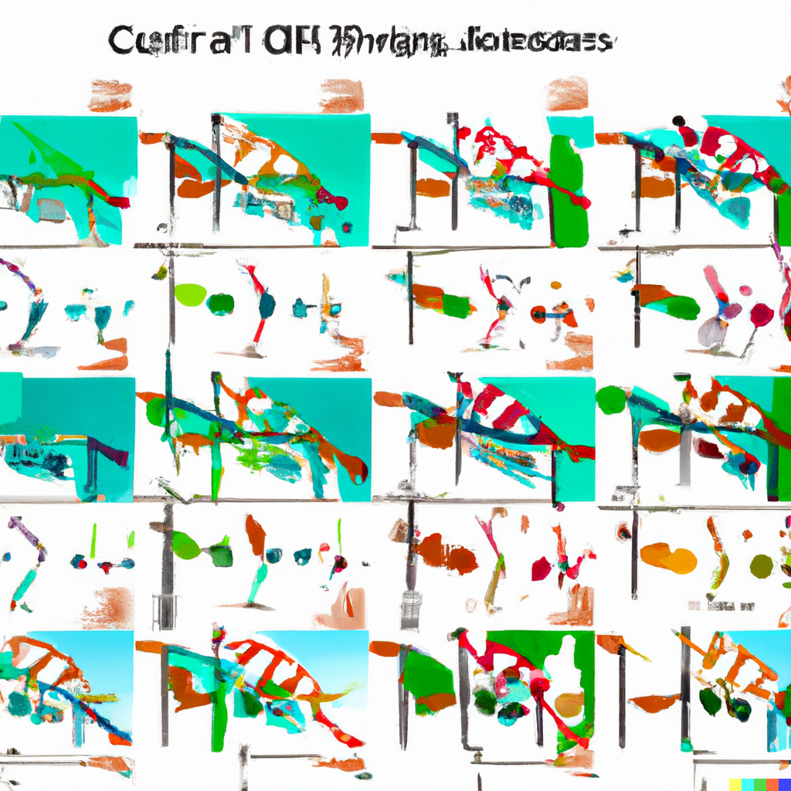
Results
What about the role of genetic drift???
credit: DALLE.E

Slide 18
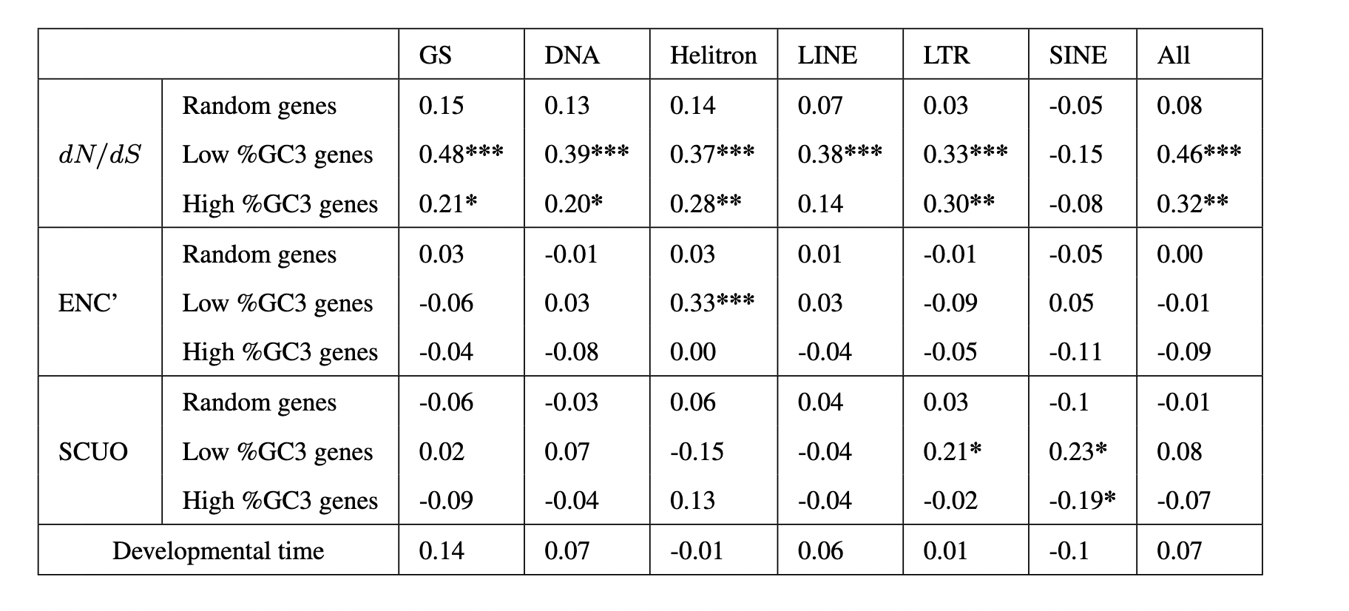
Results
Correlation coefficients between genome size, TE abundances and proxies of Ne using coevol. ***pp< 0.025 or pp >0.975 ; **pp< 0.05 or pp >0.95 ; *pp< 0.1 or pp >0.9

Slide 19
Results
No evidence for any drift effect on GS or TE content
Correlation coefficients between genome size, TE abundances and proxies of Ne using coevol. ***pp< 0.025 or pp >0.975 ; **pp< 0.05 or pp >0.95 ; *pp< 0.1 or pp >0.9

Slide 20
But GC content not independent of selection pressure
Selection is acting on codon usage in fruit flies (Duret and Mouchiroud, 1999)
19 preferred codons of 20 end in G or C in Drosophila (Marais et al. 2001).
GC-rich genes expected to be more highly expressed and under stronger selection than GC-poor genes.
Need to analyze separately GC-rich and GC-poor genes.

Slide 21
Results
Correlation coefficients between genome size, TE abundances and proxies of Ne using coevol. ***pp< 0.025 or pp >0.975 ; **pp< 0.05 or pp >0.95 ; *pp< 0.1 or pp >0.9

Slide 22
Results
Strong support for relationship between selection efficacy (dn/ds) and GS or TE content
Correlation coefficients between genome size, TE abundances and proxies of Ne using coevol. ***pp< 0.025 or pp >0.975 ; **pp< 0.05 or pp >0.95 ; *pp< 0.1 or pp >0.9

Slide 23
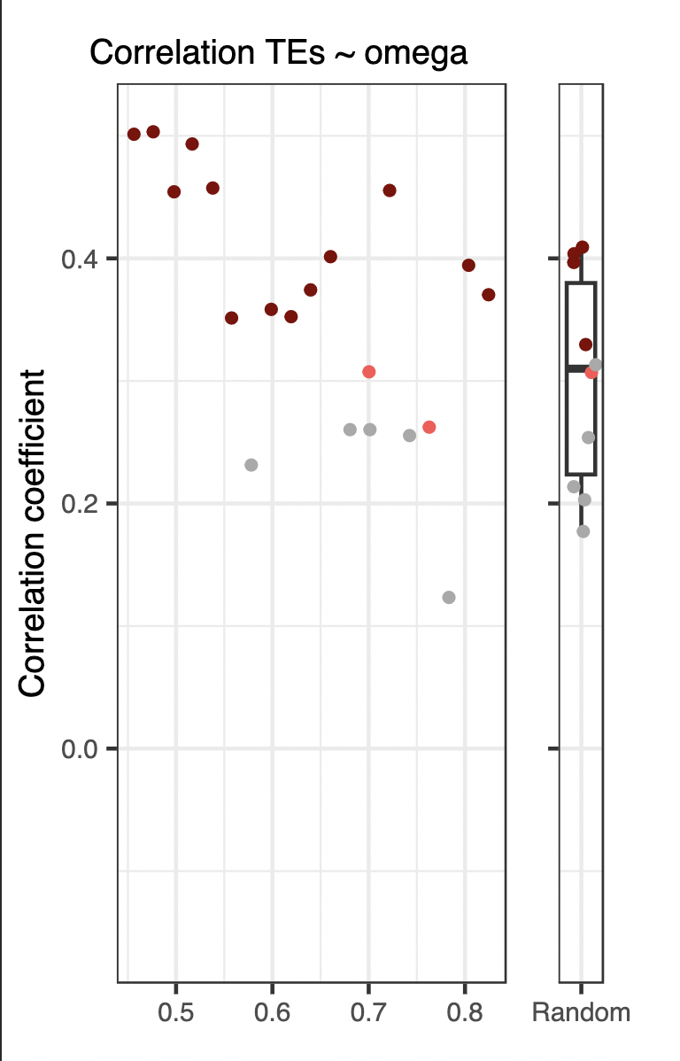
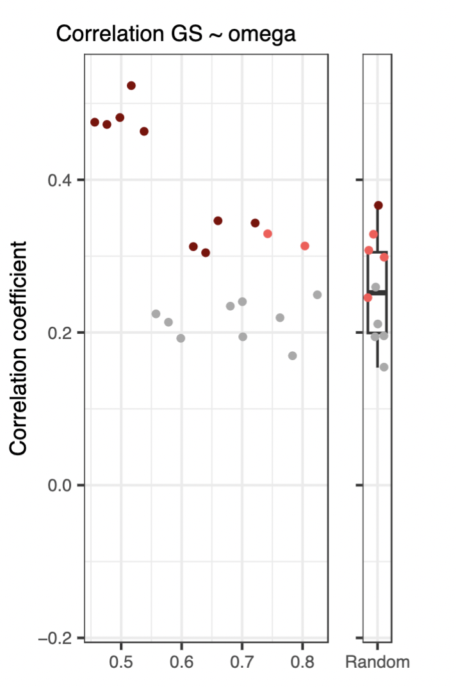
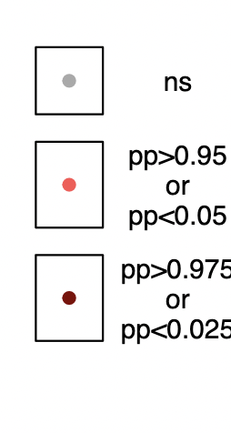
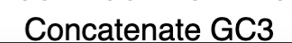
GC3 content as a confonding factor
The correlation coefficient between dn/ds and TE content decreases as the average in GC3 content of the concatenated genes increases.

Slide 24
Hypotheses
GC-poor genes under weaker selection: accumulation of deleterious mutations in Ne reduced species (slightly deleterious mutations act as neutral)
GC-rich genes under strong selection: even Ne reduced species prevent fixations of non synonymous deleterious mutations.
GC-rich genes under selection for codon usage: ds is not neutral, is dn/ds still a good estimate to Ne?
Random sets of genes: GC heterogeneity affects codon frequency estimates leading to less accurate estimates of dn/ds values

Slide 25
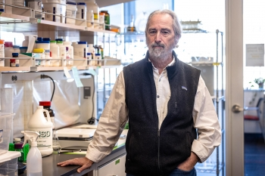

Conclusions
Genome size and TE abundance are positively correlated within flies.
We found a strong support for a relationship between a long term estimate of Ne (dn/ds) and both genome size and TE content, in agreement with Lynch Mutational Hazard hypothesis.
Need to control for GC heterogeneity among genes to be able to detect the relationship, possibly due to:
Reduced accuracy in Ne estimates
Confounding effect of selection on codon usage

Slide 26

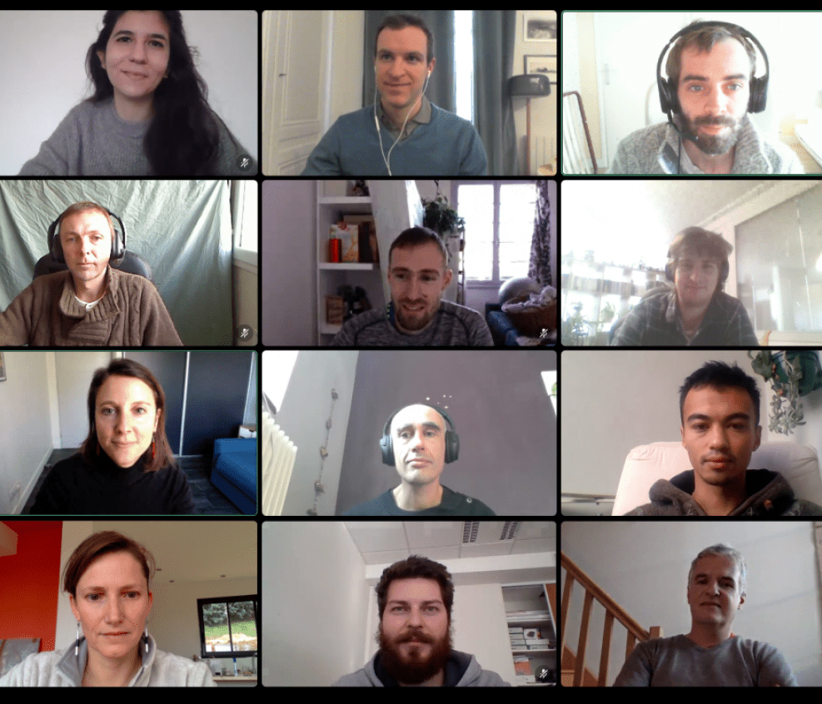




















Thank you to
Every members of the teams: ex-TREEP, Le Cocon

Slide 28
Which estimates for Ne?
Life History Traits: collection of developmental times estimates from litterature
Evolutionary rate
Strength of selection on Codon Usage Bias
Arg Lys Pro _ Ile Gln Asn Gly Gln
Human CGC AAA CCC --- ATT CAG AAT GGC CAG
Mouse CGC AAG GCC CCG ATG CAG AAT GGT CAG
Arg Lys Ala Pro Met Gln Asn Gly Gln
synonymous substitution rate
non-synonymous substitution rate
out



a







b
d_{N}




c
~ long-term estimate of Ne





d_{S}




d

Slide 29
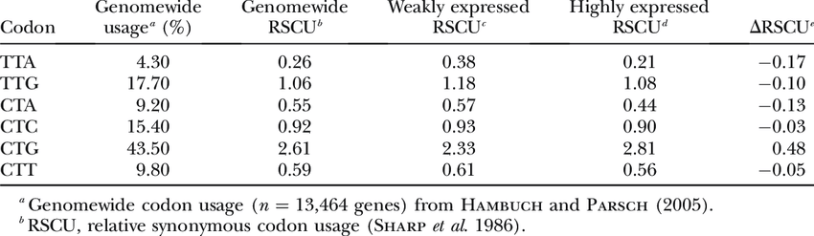
Non random synonymous codon usage, with some preferred codons, which frequency corresponds to most frequent tRNA. More preferred codons => More efficient translation
Codon Usage Bias
Are synonymous substitutions really neutral?
CTA -> CTG
Leu Leu

Slide 30

Codon Usage Bias under selection in D. melanogaster
Level of gene expression
null
low
medium
high
Fq (pref.cod.)
« We find that selection in favor of preferred codons ranges from weak (|N_{e}s| ∼ 1) to strong (|N_{e}s| > 10), with strong selection acting on 10-20% of synonymous sites in preferred codons »
0.70
0.65
0.60
0.55
< 333 aa
333-570 aa
> 570 aa
Protein length
n= 1550 genes
Duret Mouchiroud PNAS 1999
Machado et al. Genetics 2020

Slide 31
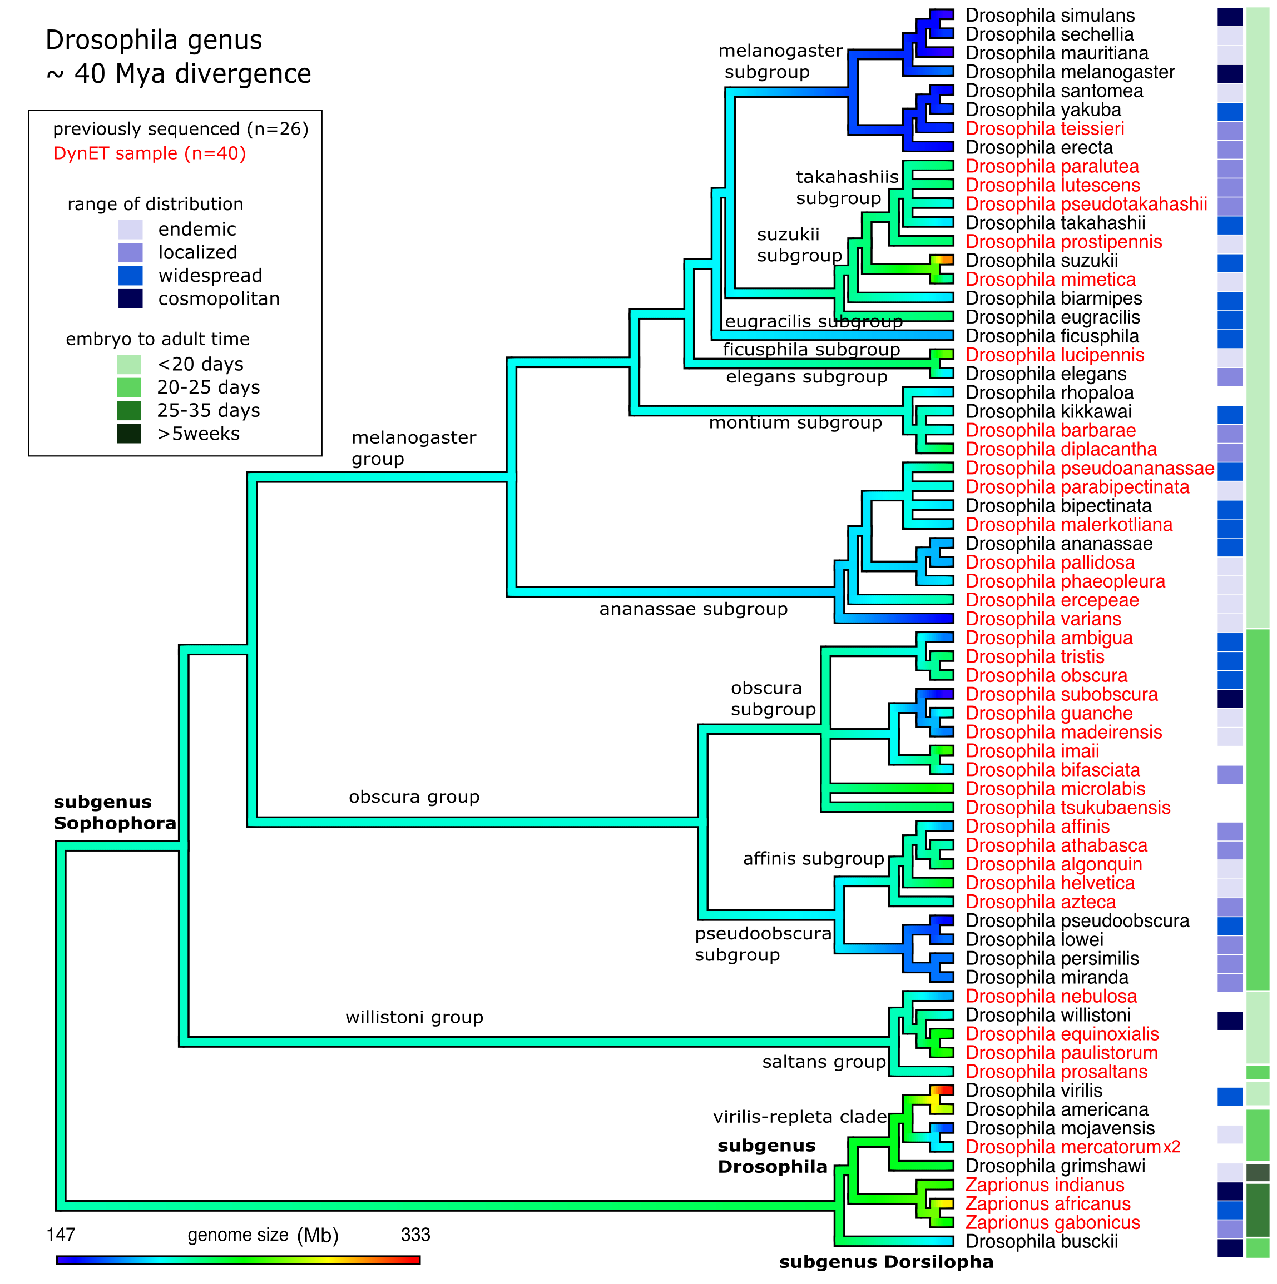
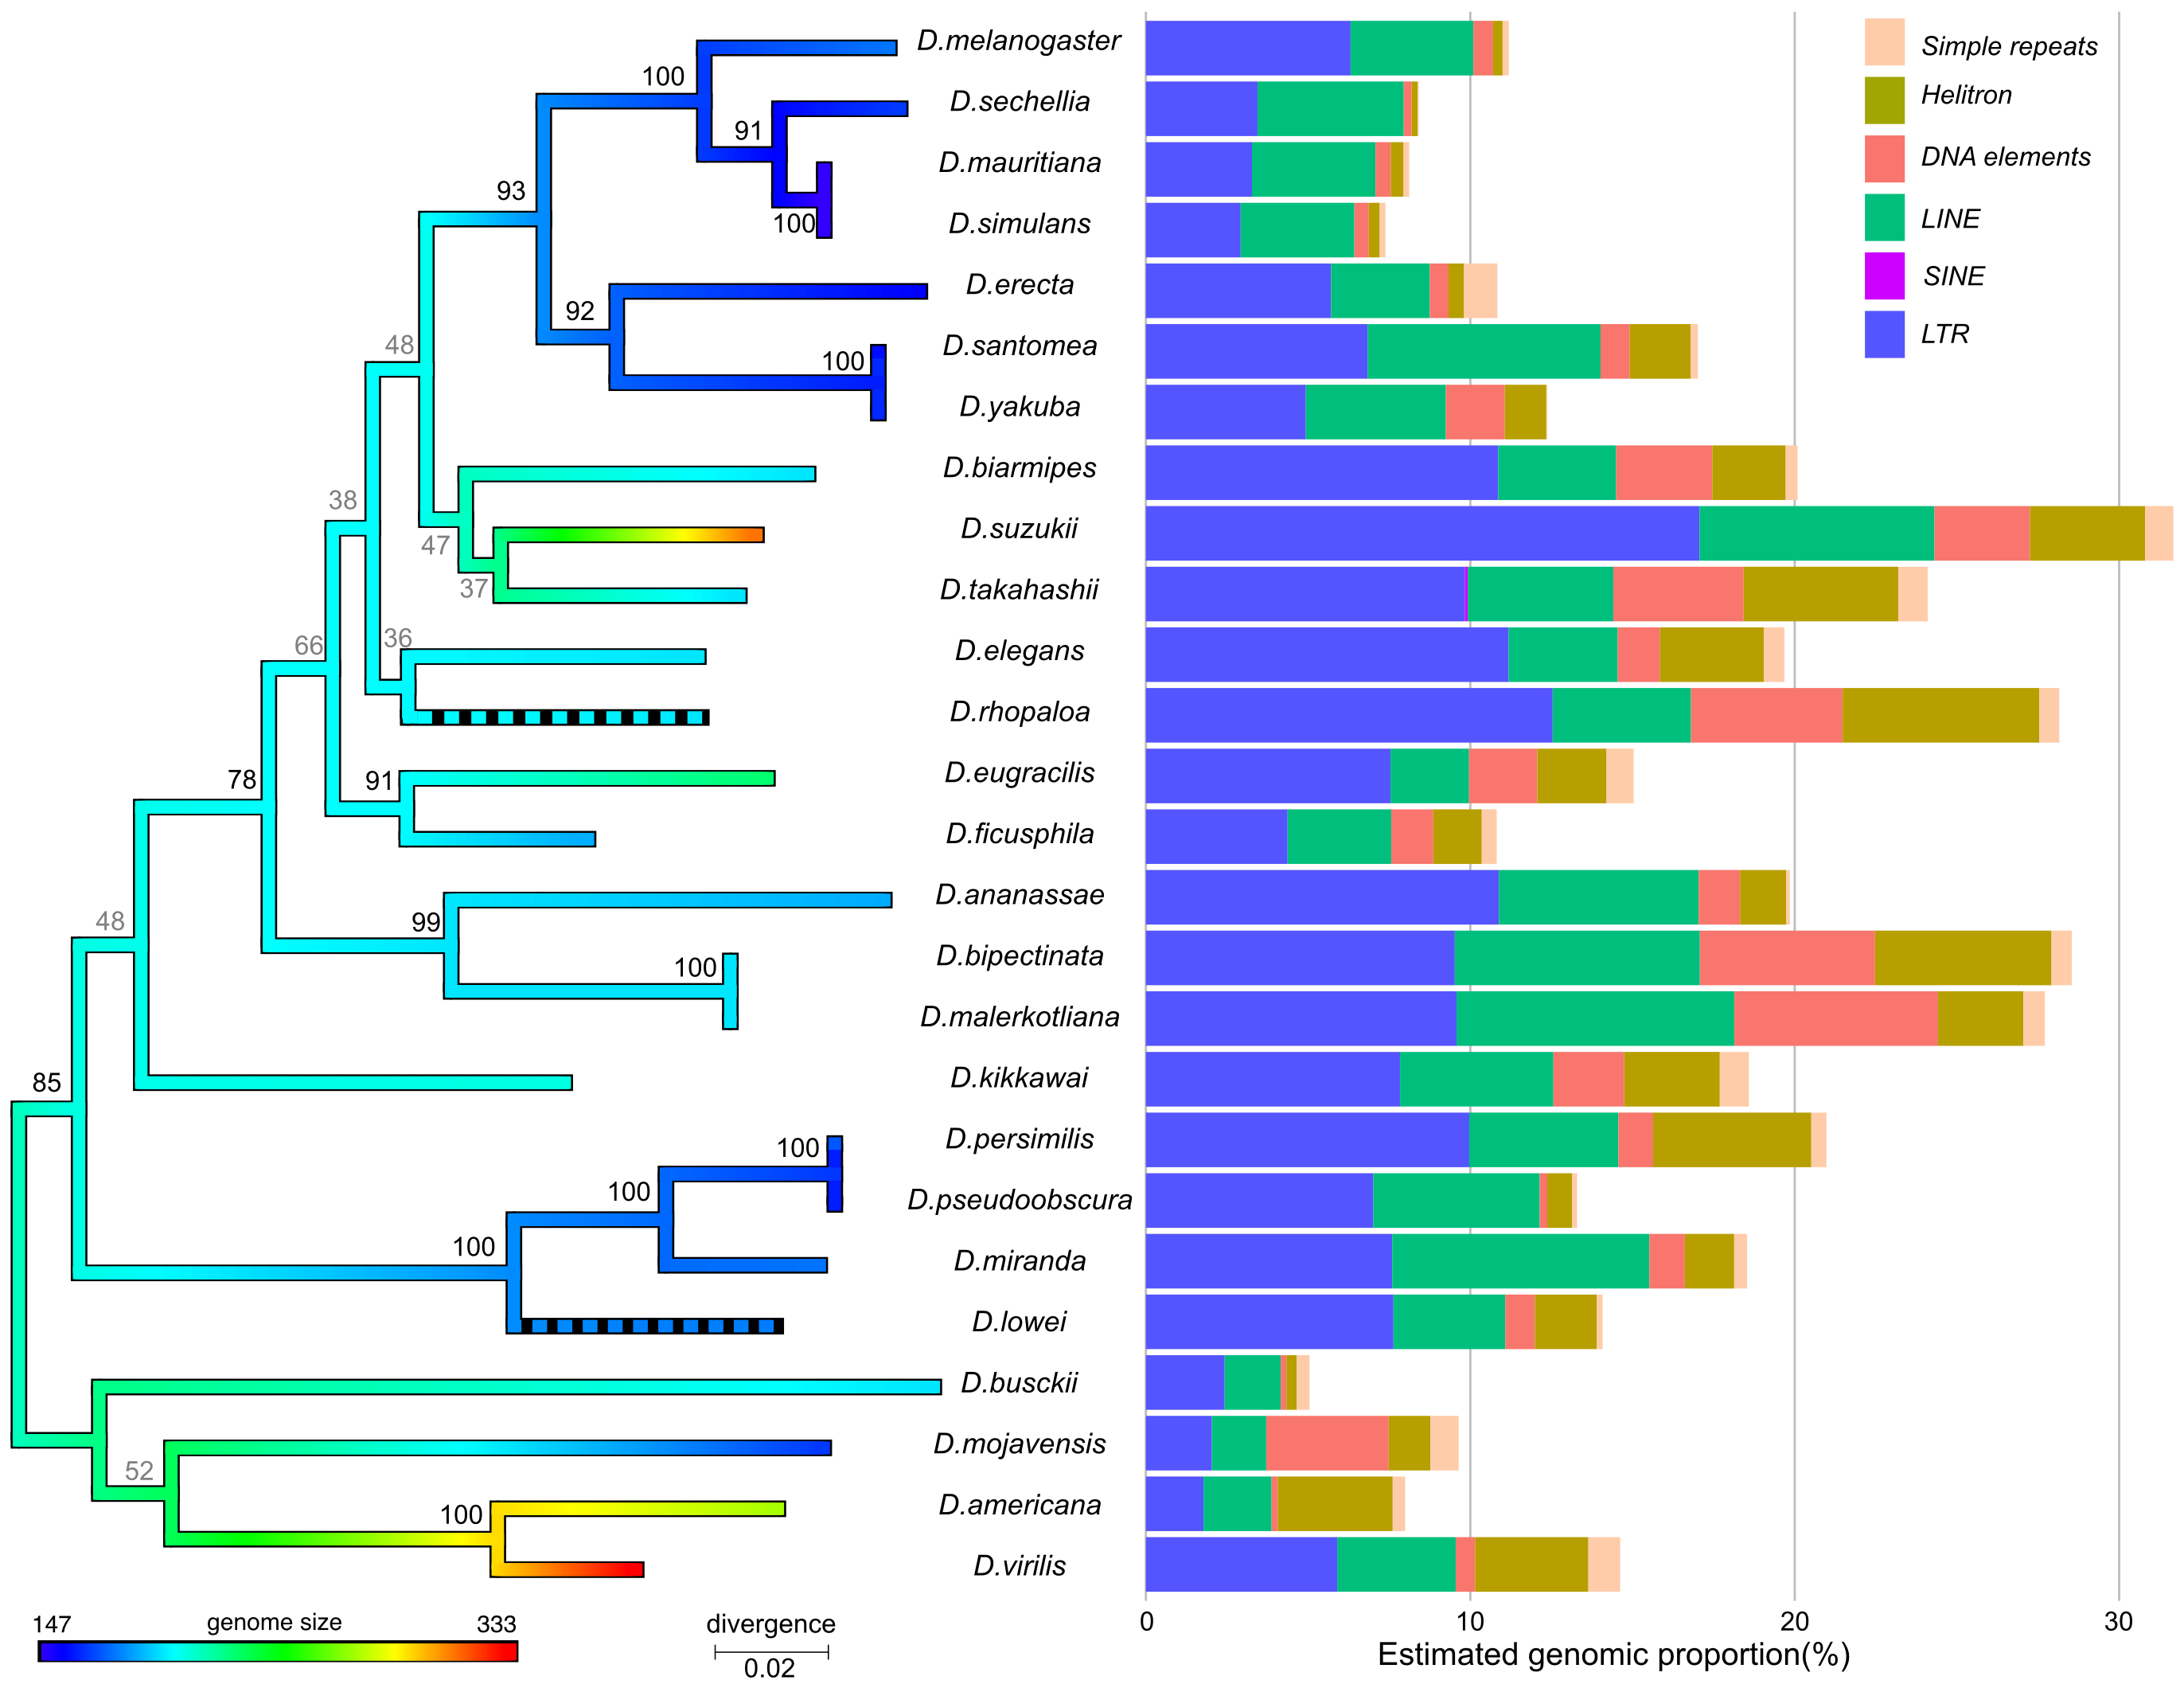
How much variation in genome size is explained by the phylogeny?
Pagel’s λ=0.98
Pagel’s λ=0.5
Sessegolo et al. Biology Letters (2016)

Slide 32
How much variation in genome size is explained by the phylogeny?
Pagel’s λ=0.98
Pagel’s λ=0.59
Genome size:
137Mb in D. busckii to
333 Mb in D. virilis.
TE content:
3.5Mb in D. busckii to
120Mb for D. suzukii.
Sessegolo et al. Biology Letters (2016)
Merel et al. Coming soon
Notes:
Genome size ranges from 136.92 Mb for D. busckii to 332.52 Mb for D. virilis.
TE content ranges from 3.48 Mb for D. busckii to
120.42 Mb for D. suzukii.
Genome size ranges from 136.92 Mb for D. busckii to 332.52 Mb for D. virilis.
TE content ranges from 3.48 Mb for D. busckii to
120.42 Mb for D. suzukii.

Slide 33
Non random synonymous codon usage, with some preferred codons, which frequency corresponds to most frequent tRNA. Codon usage varies among and within species.
Codon Usage Bias
Are synonymous substitutions really neutral?
CCT -> CCC
Pro Pro
More preferred codons => More efficient translation

